Slide 1
Course Wrap Up
Jeff Leek
@jtleek
www.jtleek.com

Slide 2
Congratulations!

Slide 3

http://bit.ly/1OMPSTA

Slide 4
Books
Data Driven: creating a data culture
Building data science teams

Slide 5

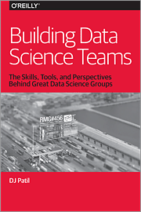
http://www.oreilly.com/data/free/building-data-science-teams.csp
http://www.oreilly.com/data/free/data-driven.csp

Slide 6
Courses
Johns Hopkins DSS
Johns Hopkins EDSS

Slide 7
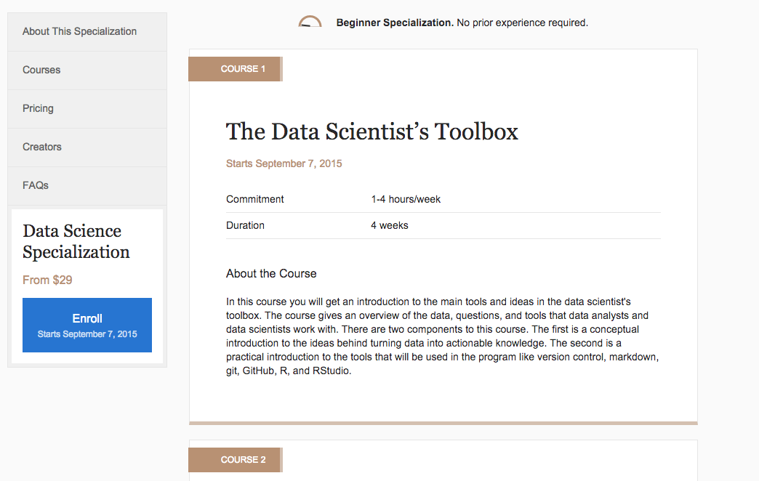
https://www.coursera.org/specializations/jhudatascience

Slide 8
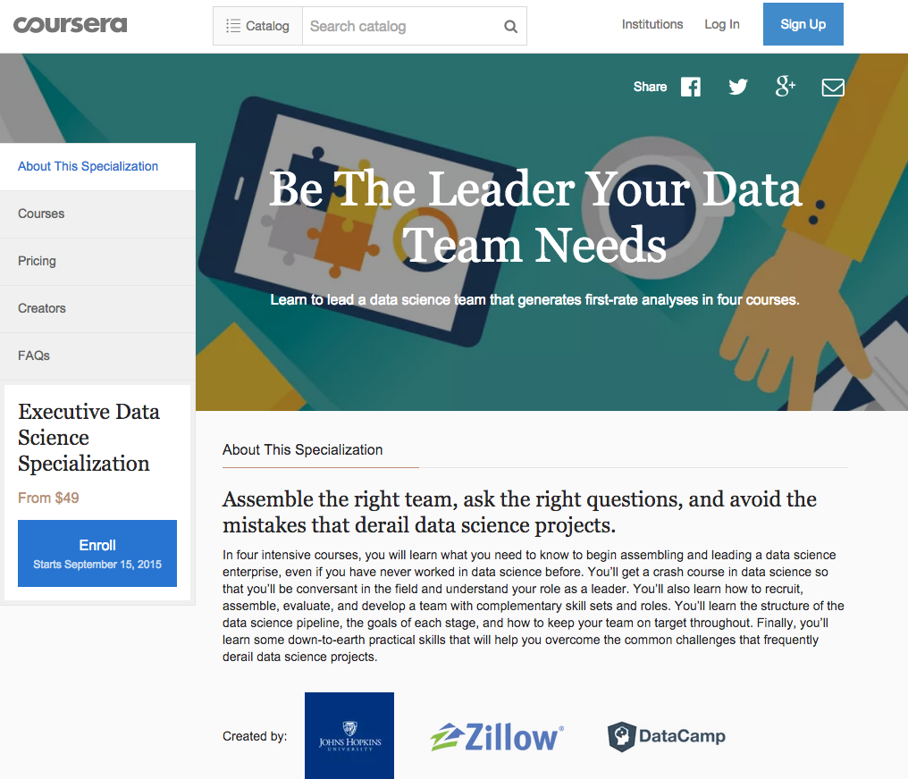
https://www.coursera.org/specializations/executive-data-science

